Slide 1

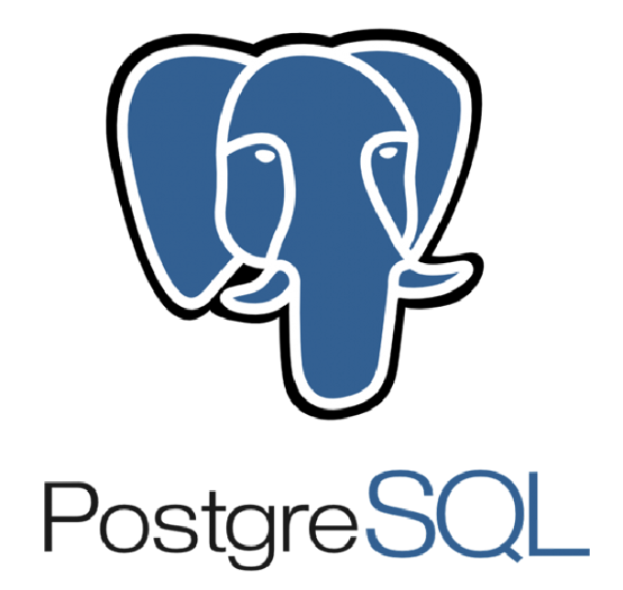



Control Table
Source data
Hadoop database
Data Lakehouse
Orchrestator
Processing and clustering

Slide 2

Control table
1
Stream_nm
M
CNTL_AF.CNTL_CFG_STREM
CNTL_AF.CTL_PRCS_GRP
M
Prcs_grp
1
M
Prcs_nm
1
Prcs_nm
M
1
CNTL_AF.CNTL_CFG_PCRS_DEPN
CNTL_AF.CNTL_CFG_PCRS
CNTL_AF.CNTL_LOG

Slide 3
CNTL_AF.CNTL_CFG_STREM
STREM_NM(string) | DATA_DT (string) | BACK_FILL_DT(string) | CALC_DT (string) | UPT_DT (timestamp)
CNTL_AF.CNTL_CFG_PRCS_GRP
PRCS_GRP (string) | STREM_NM (string) | PRIR(int) | ACT_F(int) | UPT_DT(timestamp)
CNTL_AF.CNTL_CFG_PRCS
PRCS_NM(string) | PRCS_GRP(string) | PRIR(int) | SRC_SCHM_NM(string) | SRC_TBL(string) | TGT_SCHM_NM(string) | TGT_TBL(string) | PRCS_TYP(int) | AF_PATH_NM(string) | AF_PARM (string)
ACT_F(int) | UPT_DT (timestamp)
CNTL_AF.CNTL_CFG_PRCS_DEPN
PRCS_NM(string) | DPND_PRCS_NM(string) | CHK(int) | ACT_F(int) | UPT_DT(timestamp)
CNTL_AF.CNTL_CFG_LOG
PRCS_NM(string) | START_DT(timestamp) | END_DT(timestamp) | STATUS(int) | MESSAGE(string) | SOURCE_ROW(int) | TARGET_ROW(int) | UPT_DT(timestamp)

Slide 4
V Framework
Task_00
STREM_NM
Email
Pass variable config
true
Task_10
PROCESS_GROUP
Pass variable config
true
Task_20
PROCESS_NAME
Check reconclie
true
Pass variable config
Up stream
Config
Task_30
CHK_DPND
true
Pass variable config
Task_40
RUN_PROCESS

Slide 5
General task step defined in dwh.py
1. get task detail configuration parameter (e.g. strem, prcs grp, prcs nm,prcs detail, dependency, log or check dependency) from postgres control table recieve in dict format
2.initiate parameter to class framework (controller)
3.iterate over prcs through it dependency and execute each prcs by checking log detail in condition
4. running method bash: some_path –strem_nm –runmode → main.py execute python file by loop all process in proces_nm and all procs_grp in strem_nm by file in sciprt path will not be dag in the file
By having bash file and execute app.py by loop app.py –prcs1, app.py –prcs2 and make it able to passing config
ตอนนี้ทำ logging โดยต้องดูเรื่อง calculate_date แล้วก็ logging ที่อาจจะต้อง insert กับ check แค่ datetime ที่มี time คือ 00:00:00 เพื่อไม่ให้ insert log มากเกินไป

Slide 6
Job frame work architect
--build script command for stg and none stg command(dim fact agg) by store parquet in data lake and persist data in RDBMS.
App.py for build necessary code to run a process
Make a dag file for dag_strem.py to trigger start process by it dependency while dag_stream.py and dag_process.py will be exists in airflow console

Slide 7
Depn_1
Prcs_nm
Depn_2
Prcs_grp
Depn_1
Strem_nm
Prcs_nm
Depn_2
Prcs_grp
Prcs_nm

